Slide 1
AS Features Figures
Fluvio L Lobo Fenoglietto

Slide 2
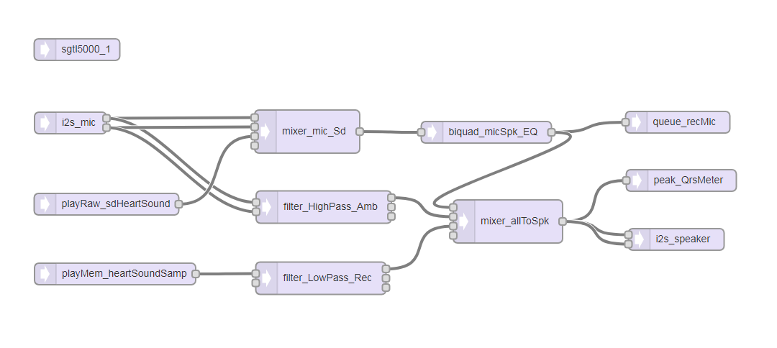

Slide 3
Feature: Play audio from memory

